Slide 1
Quarantine Adventure Guide
Jabbas
Angelica Calderon, Selin Bayraktaroglu, Heather Tzou, Lars Arienti, Julia Leonoff

Slide 2
Project Overview
Our story reflects our current state of affairs - what do we do during quarantine?
We streamlined your choices down to two:
Staying inside to watch a movie or
Going outside for a hike.
Briefly consider your options, then decide your fate.

Slide 3
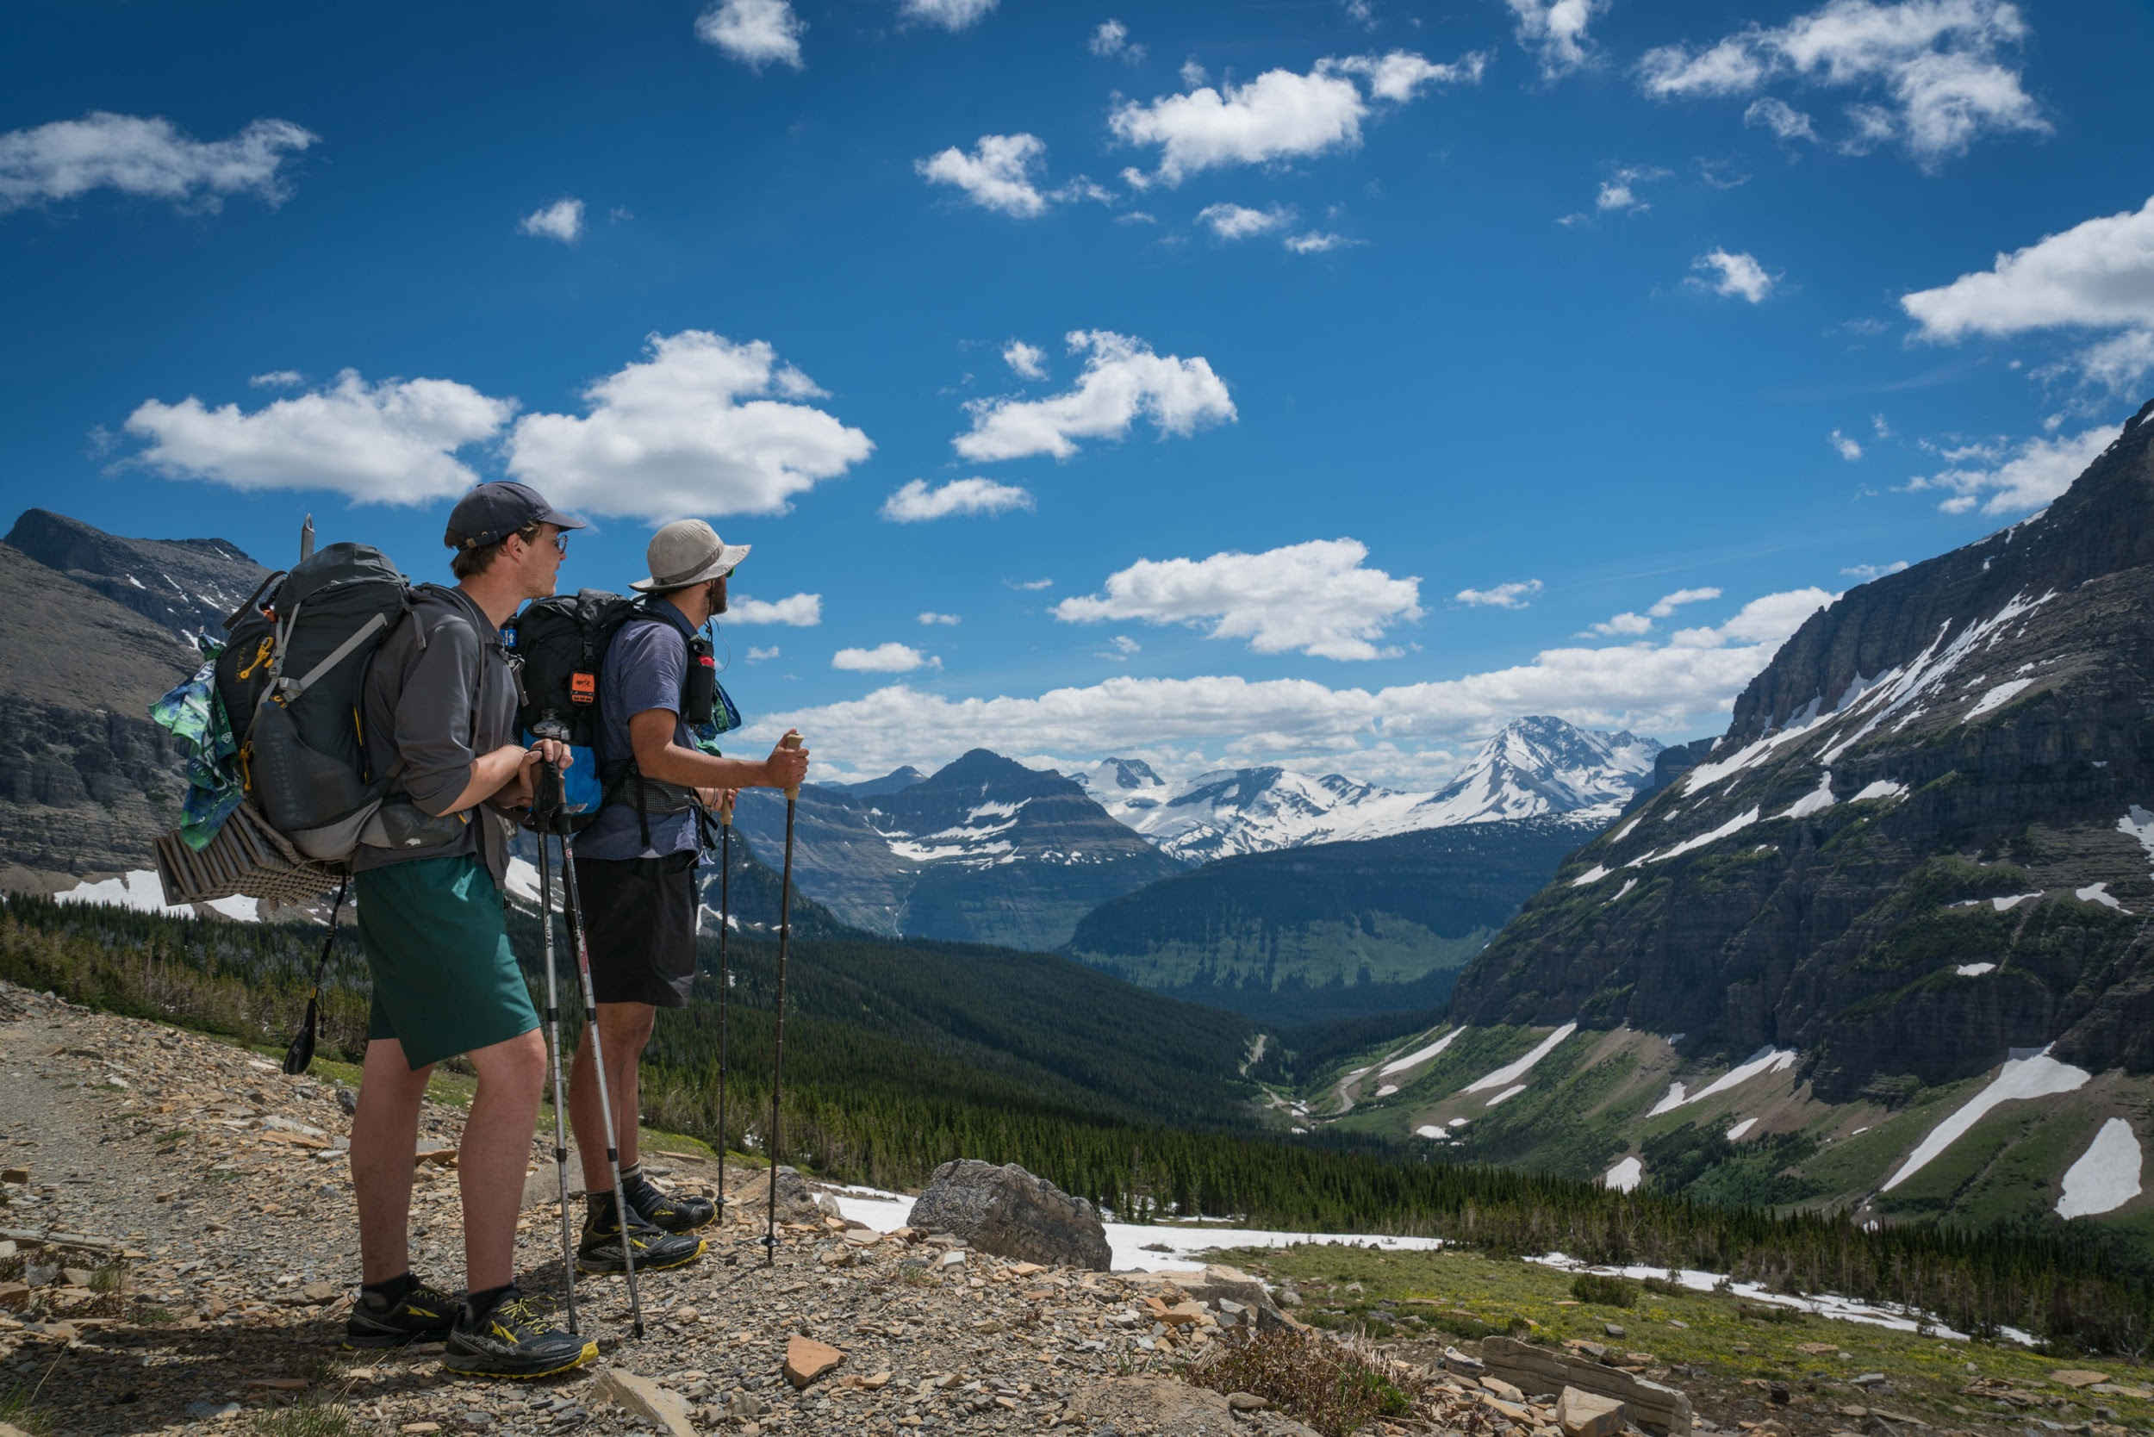
LET’S GO ON A HIKE!

Slide 4

LET’S WATCH A MOVIE!

Slide 5

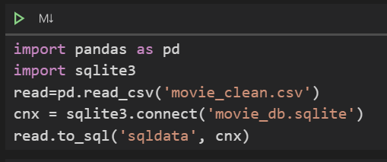
Data Preparation
Create SQLite db in pandas: IMDB movies, zip codes

Slide 6
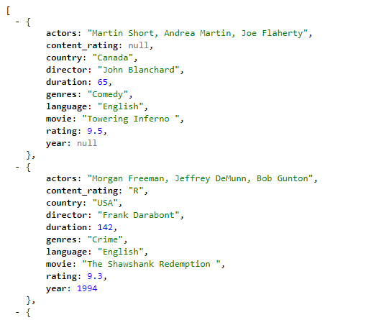
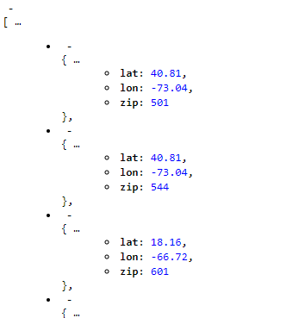
Data Preparation
Flask API

Slide 7
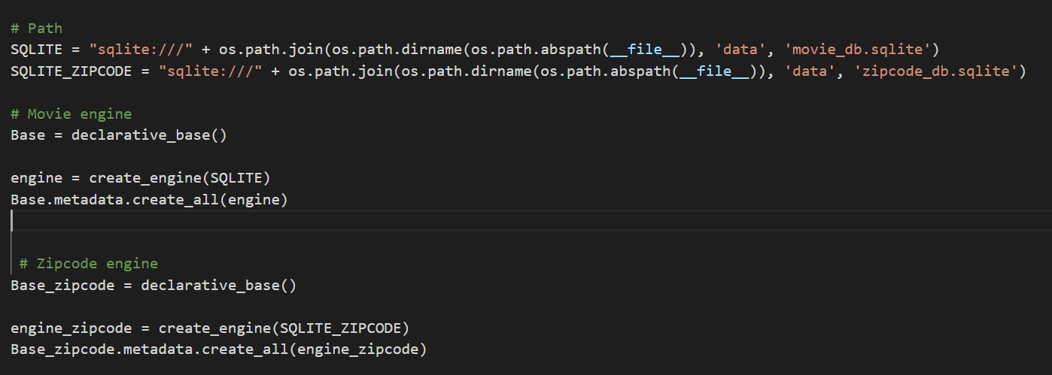
Data Preparation
Flask API - Database setup

Slide 8
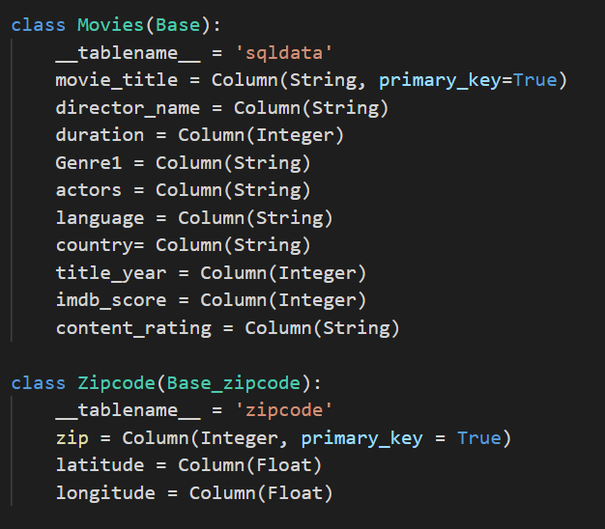
Data Preparation
Flask API - Create classes

Slide 9
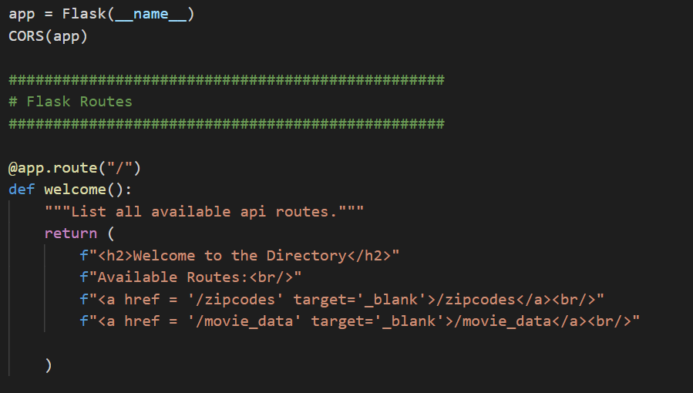
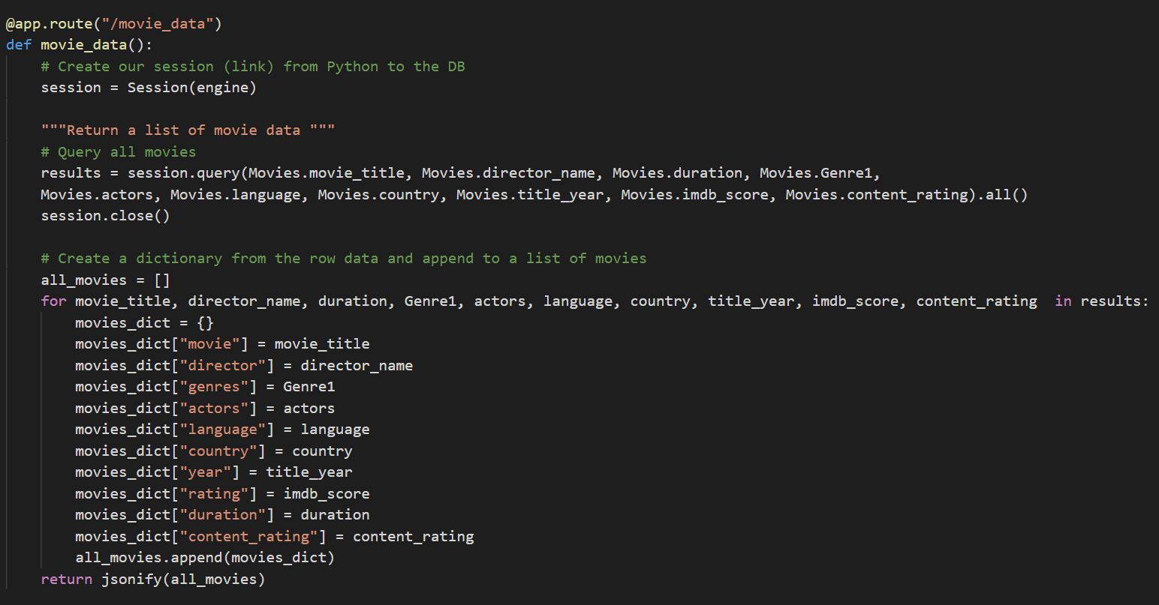
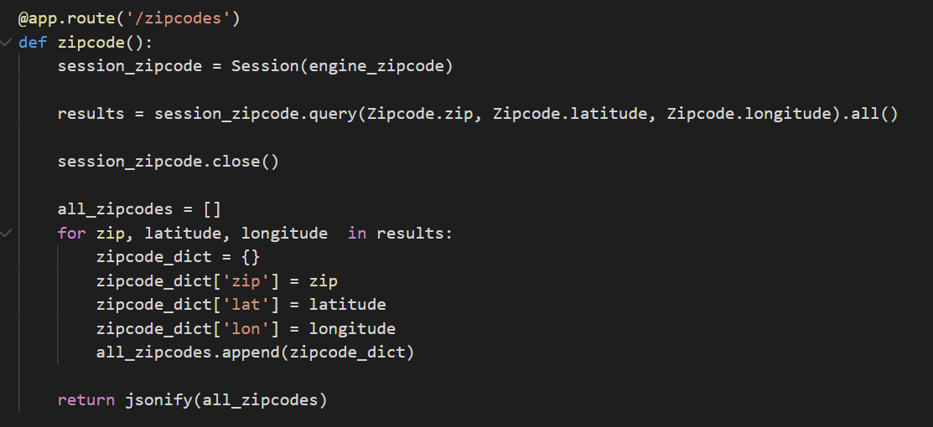
Data Preparation
Flask API - Flask setup

Slide 10
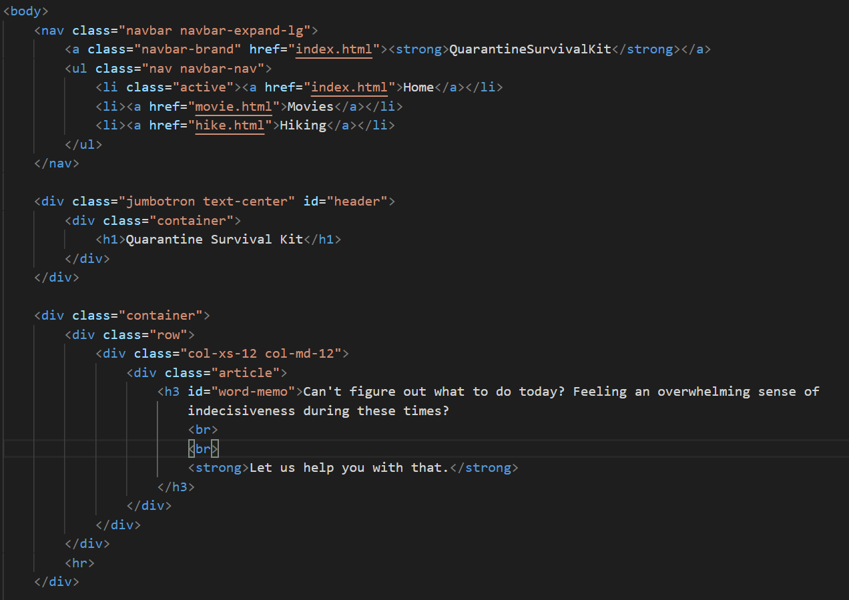
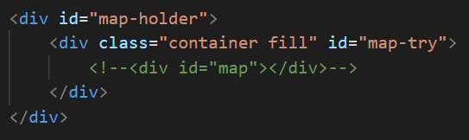
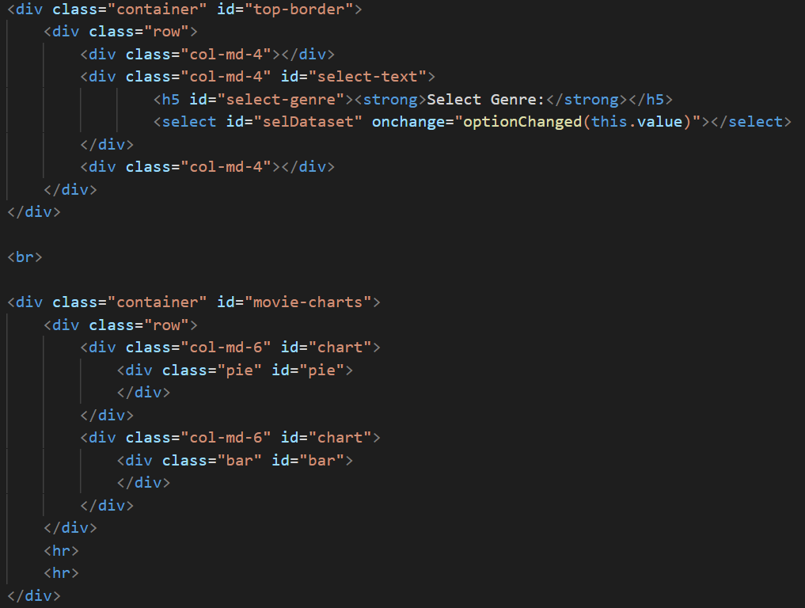
HTML
Layout
Data Matching

Slide 11
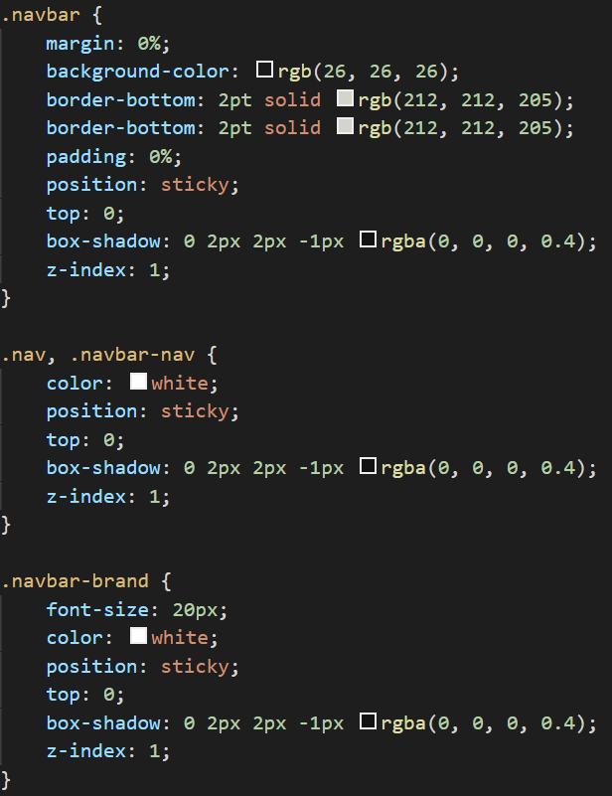
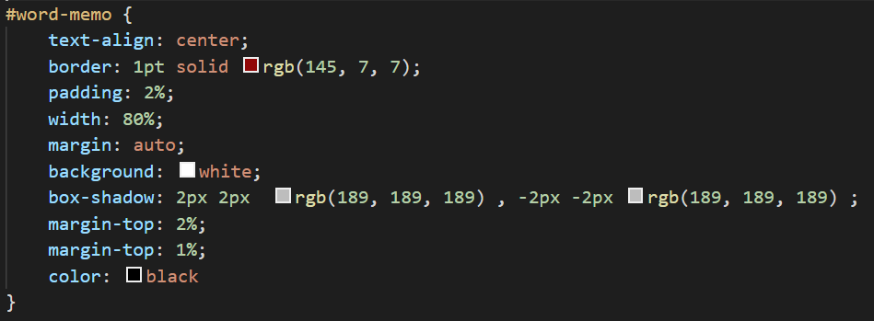
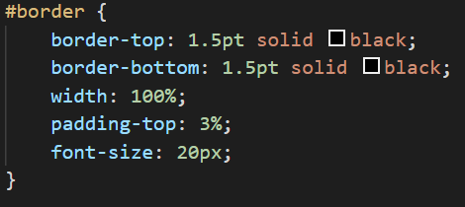
CSS
Responsive
Design

Slide 12
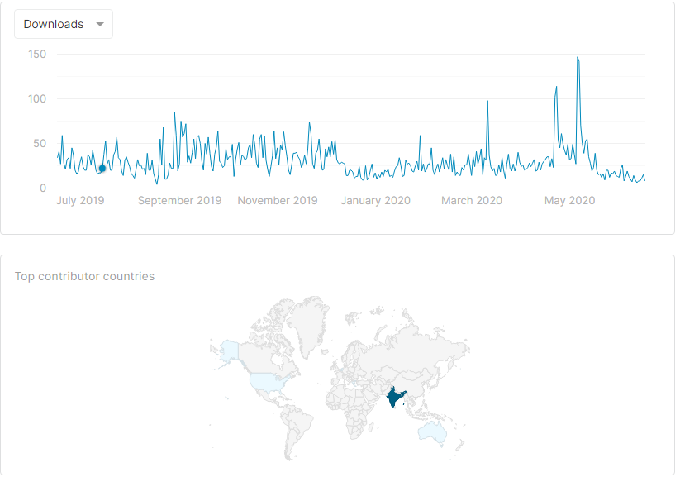
Movie Data
IMDB Movie Dataset
5000 movies
28 columns
CSV file
Data clean up

Slide 13
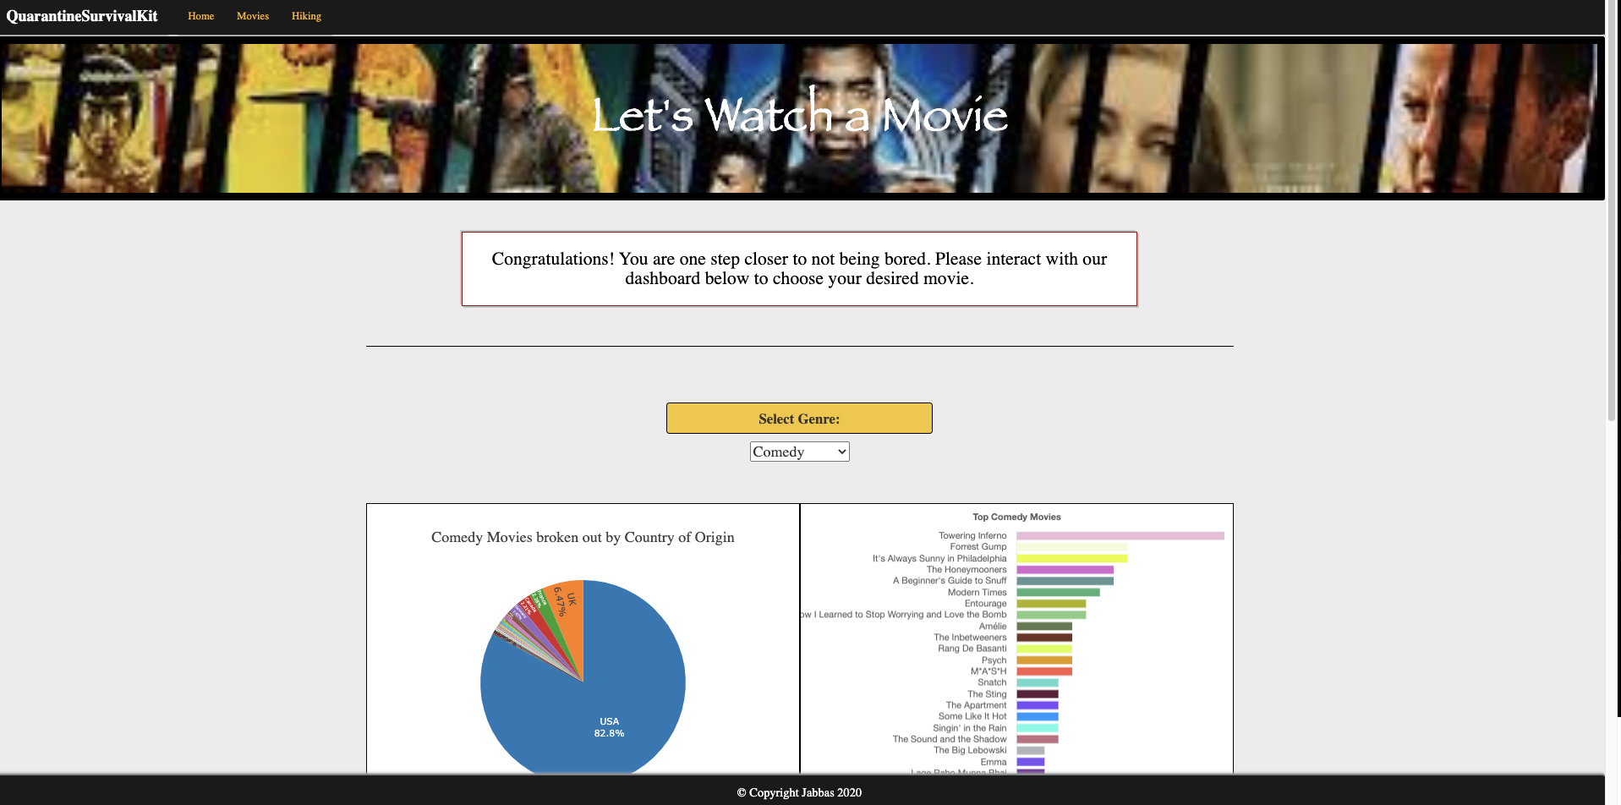
Movie Interactive Dashboard

Slide 14
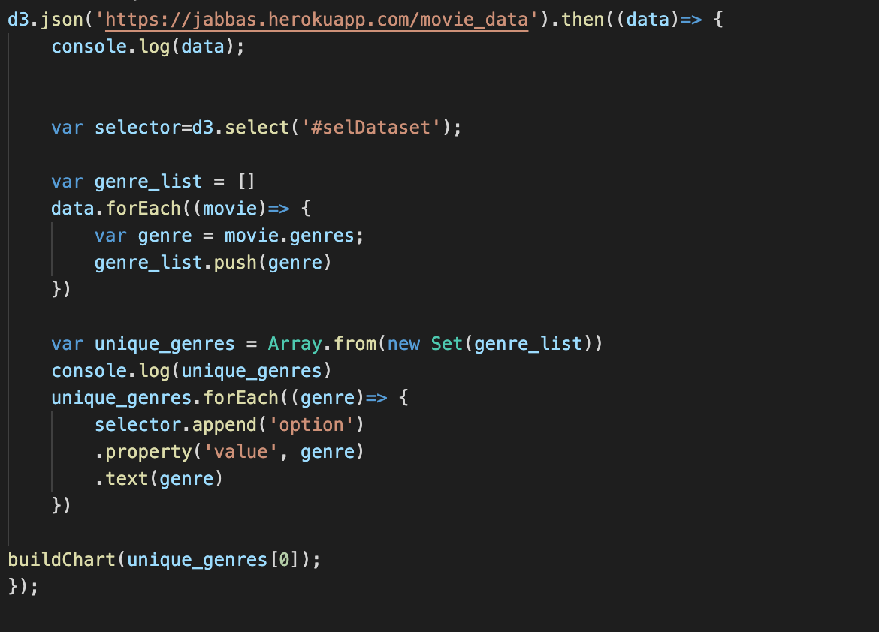
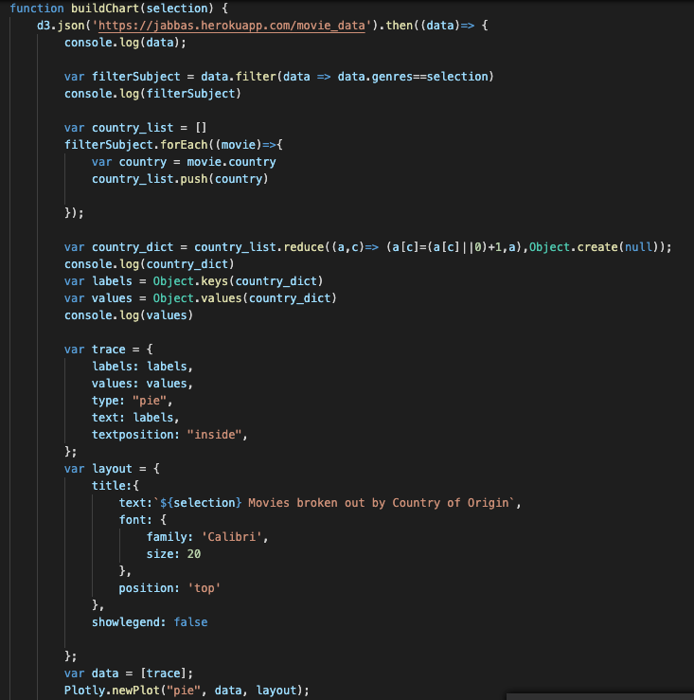
Movie Interactive Dashboard
/movie_data to obtain api data
Set value to load page
.js libraries
D3
Plotly
Chart

Slide 15
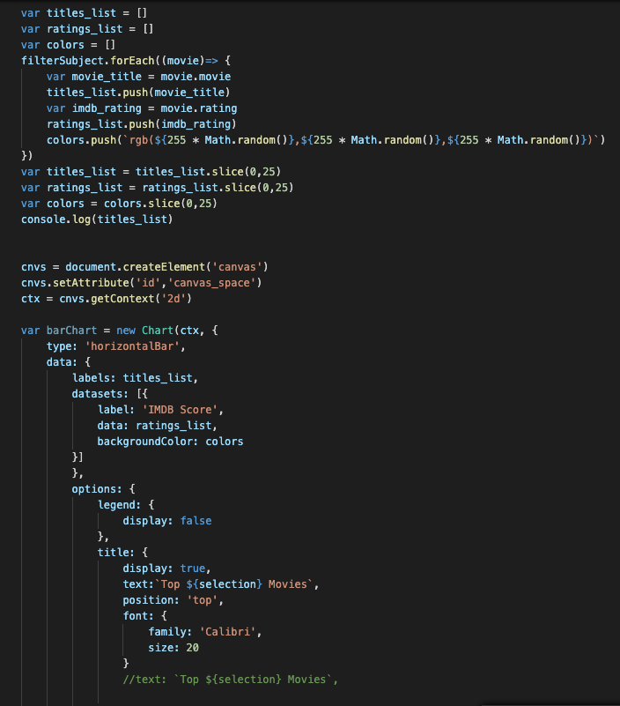

Movie Interactive Dashboard
/movie_data to obtain api data
Set value to load page
.js libraries
D3
Plotly
Chart

Slide 16
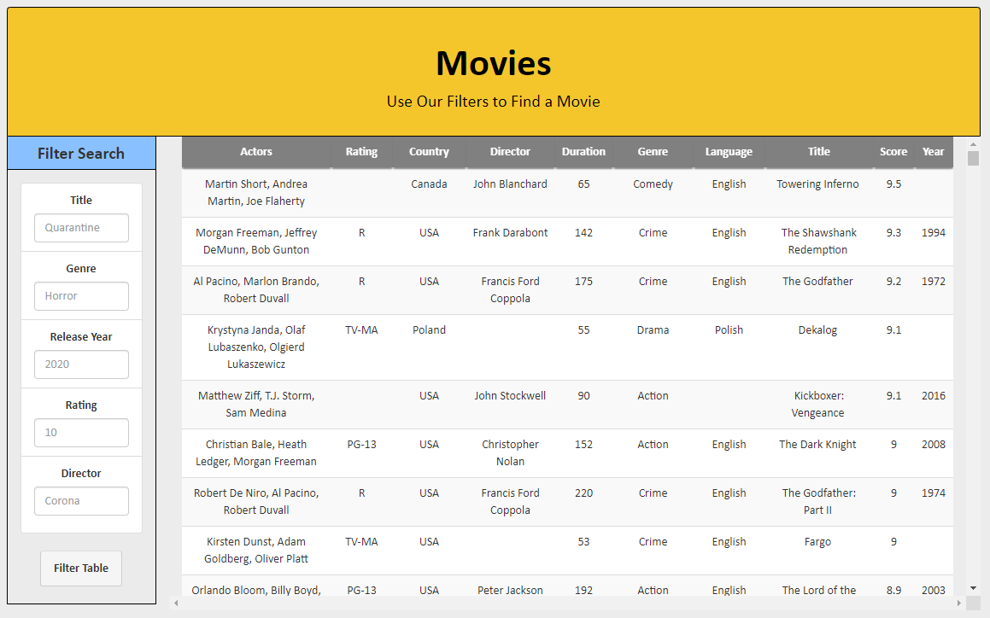
Movie Interactive Table
‘Movies’ table

Slide 17
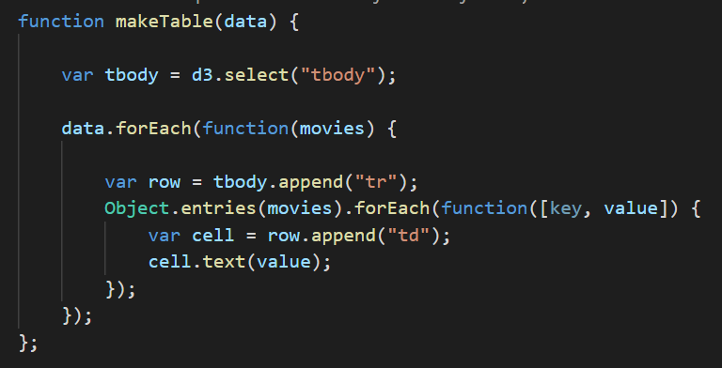
Movie Interactive Table
‘Movies’ table - Plot the pre-filtered table

Slide 18
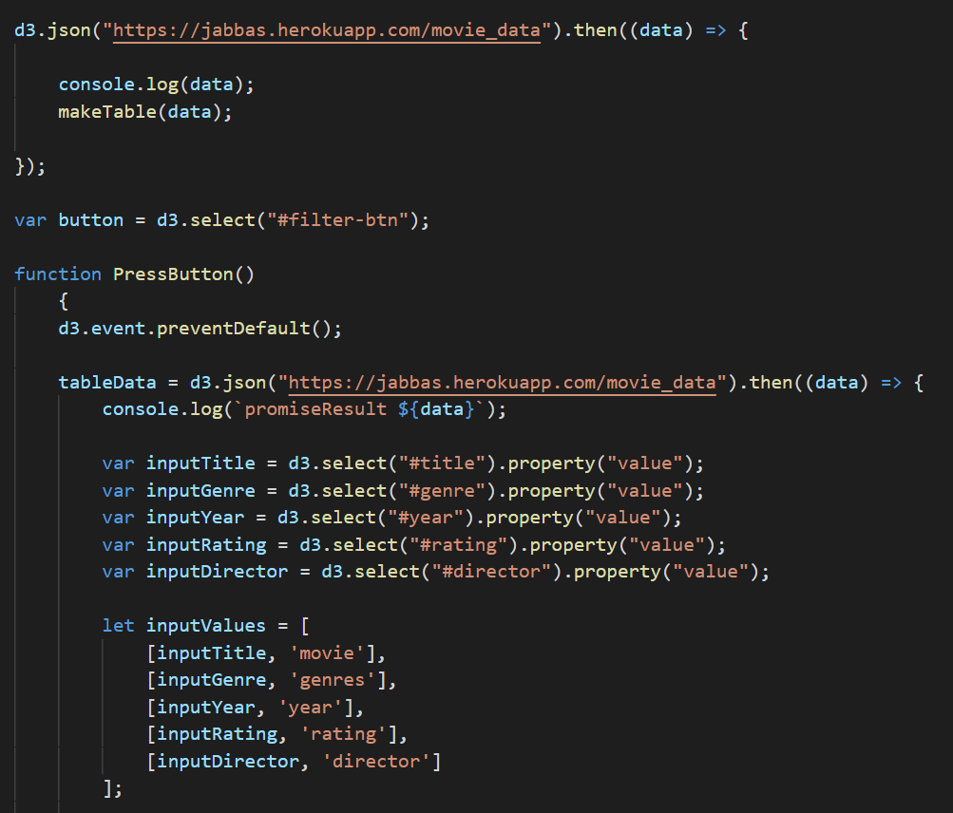
Movie Data & Interactive Dashboard
‘Movies’ table
Event listener: button click

Slide 19
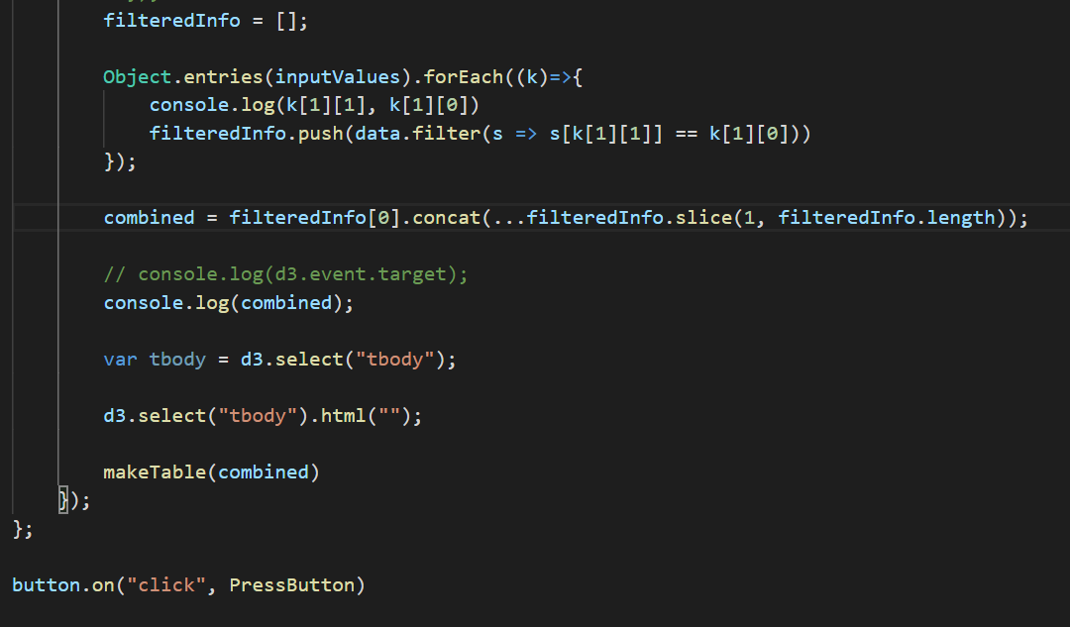
Movie Data & Interactive Dashboard
‘Movies’ table
Filter by inputs:
Title
Genre
Release year
Rating
Director

Slide 20
Mapping Hike Trails
External sources that were used:
Zip code database (CSV) - https://public.opendatasoft.com/explore/dataset/us-zip-code-latitude-and-longitude/export/
Inputted zip code will return longitude and latitude which will be used to return the nearest hiking trails on the map
Trails API - https://www.hikingproject.com/data
Receives arguments: private key, lat, and lon
Mapbox
Used to display map

Slide 21
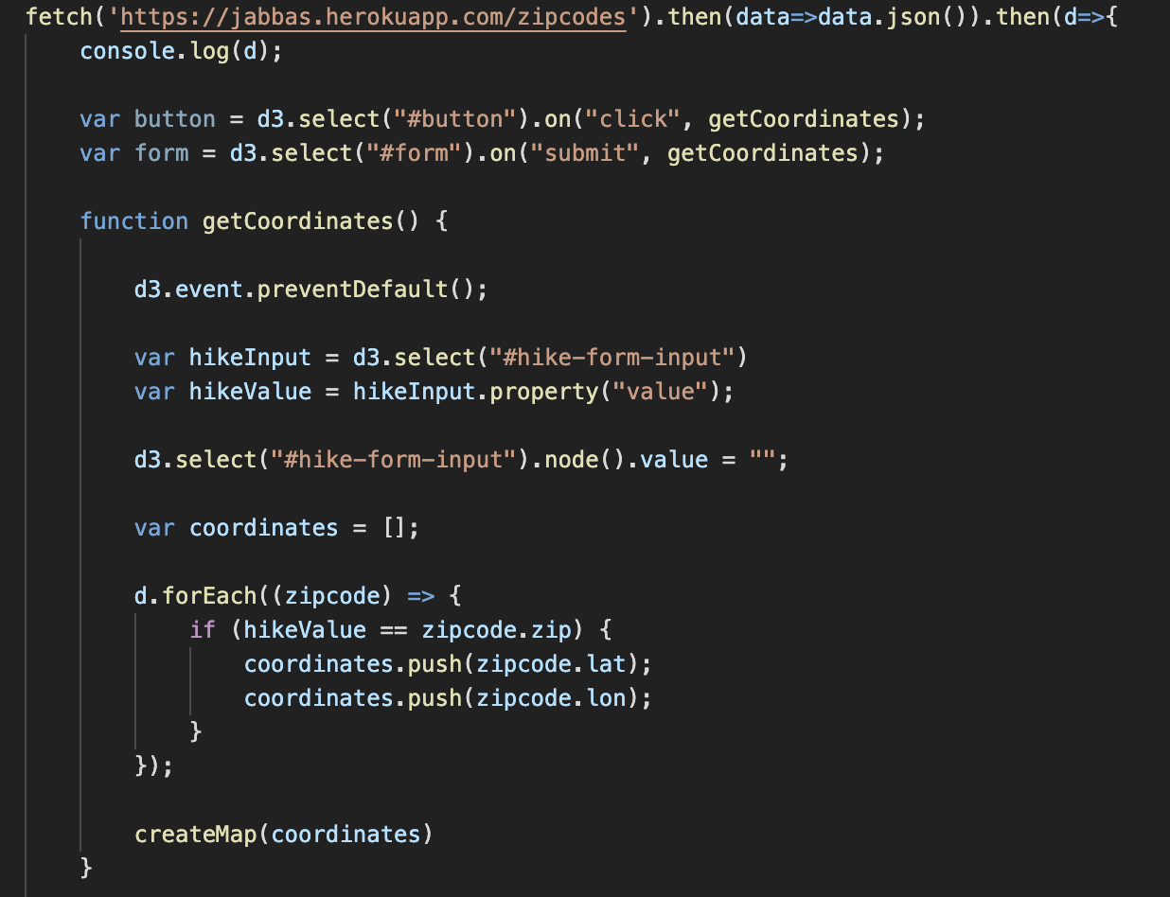
Mapping Hike Trails
Get coordinates when user enters a zip code

Slide 22
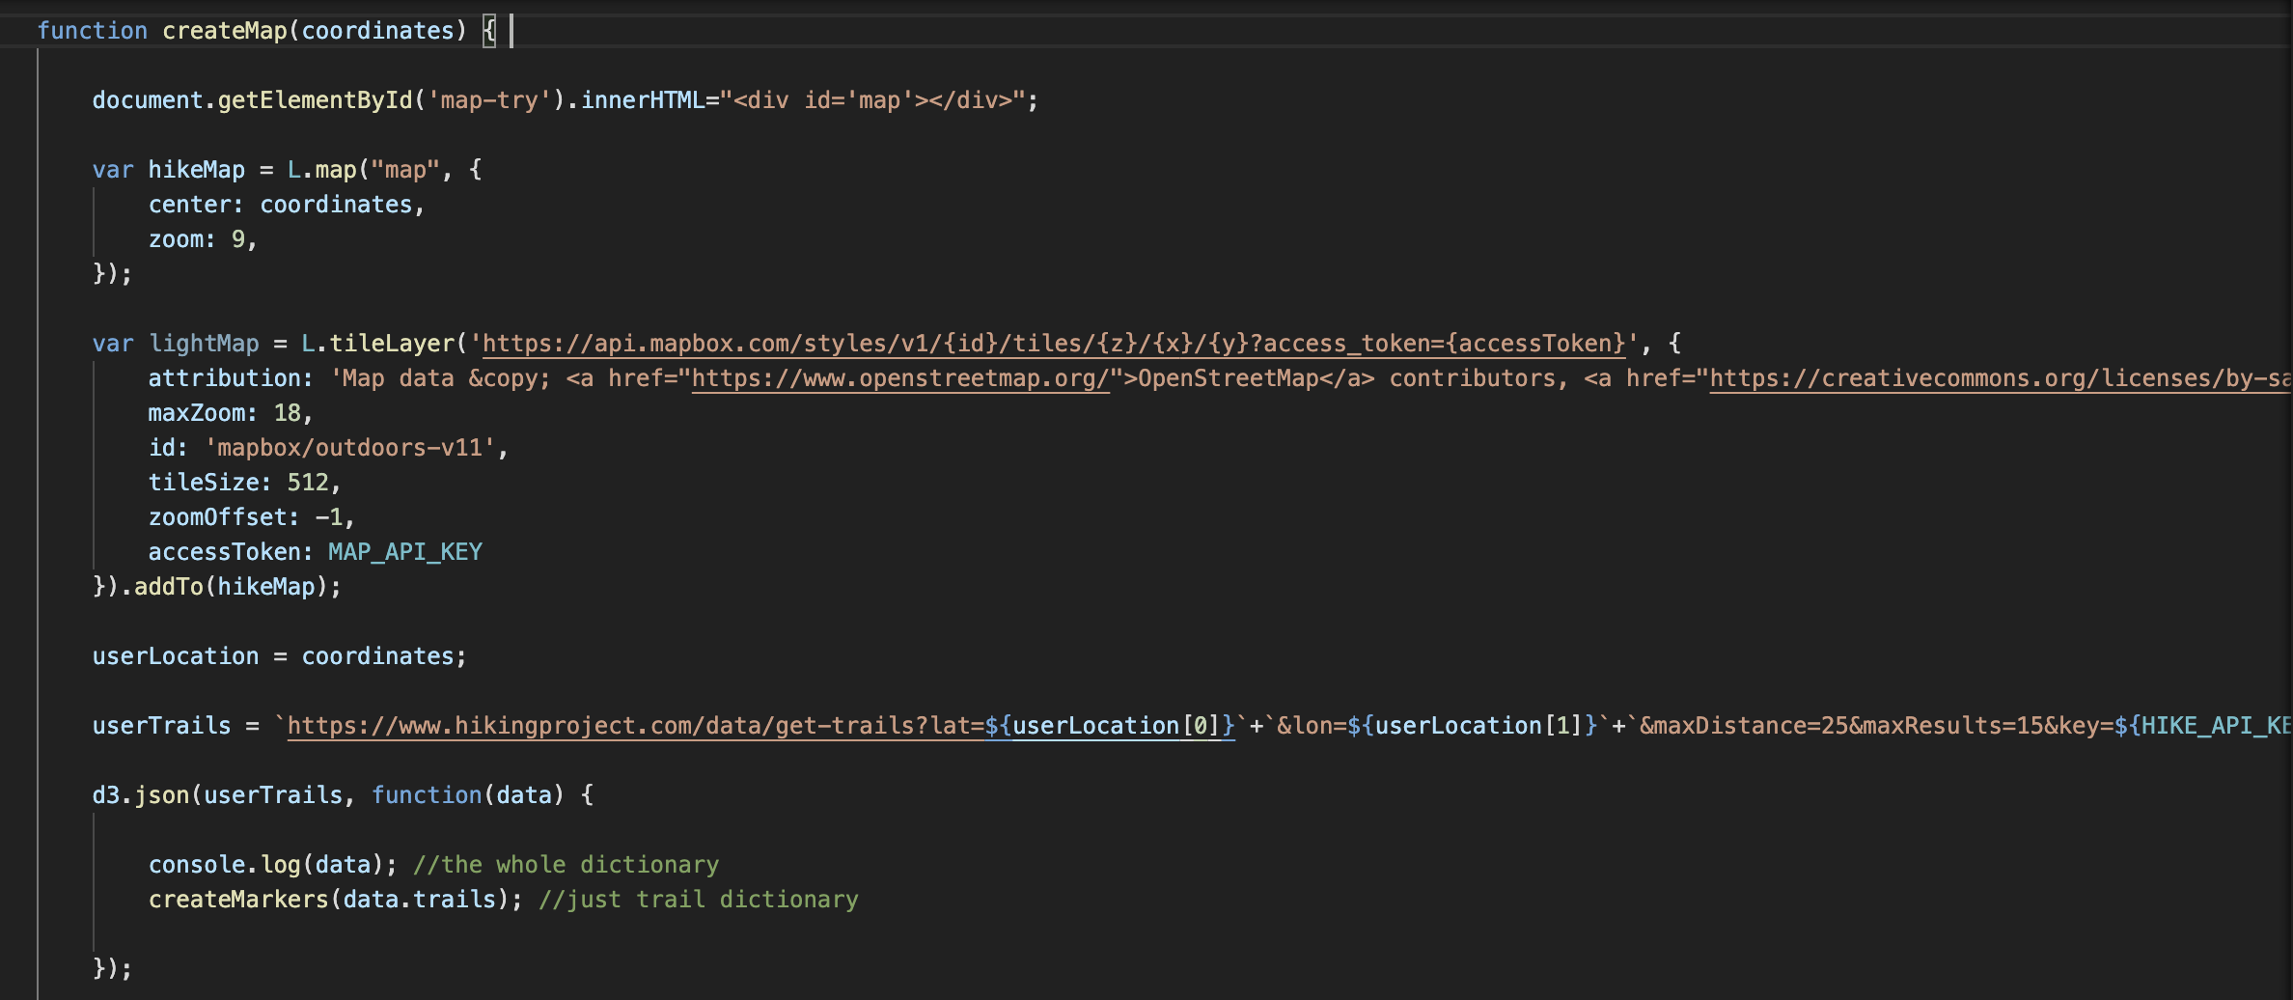
Mapping Hike Trails
Create the map using the coordinates from given query

Slide 23

Mapping Hike Trails
Plot trails - each marker contains information about trail name, summary, picture, condition, difficulty, and rating

